Slide 1

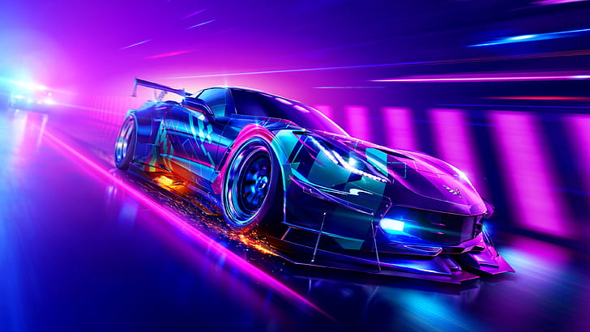
k.c.e society’s
INSTITUTE OF MANAGEMENT & RESEARCH, JALGAON
Academic Year – 2022-2023
A
Mini Project report
On
“Car Gaming”
of
Masters of Computer Application
Guided By
Name: miss. Utkarsha M.Rane

Slide 2
Group Member & GitHub Project Link
Name | Roll No | Link
Vaishnavi Kamalkishor Agrawal | 02 | https://github.com/vaishu10702/car_game
Harshal Ravindra Chavhan | 43 | https://github.com/Harshal13092001/car_gaming
Vaishnavi Pannalal Koli | 73 | https://github.com/kolivaishnvi/car_game
Prerana Anil Dhatrak | 56 | https://github.com/Preranadhatrak12/car_game2

Slide 3
INDEX
Introduction
Project Features
System Facilities
Hardware and Software Requirement
Software Process Model(using Agile Methodologies)
Preliminary Design
Screenshot
Conclusion
Future Scope
Reference

Slide 4
INTRODUCTION
Developing software applications is a time-consuming process, and with time-consuming processes come high costs. During the last years, several software development methodologies, often known as agile software development, have become widely used by software developers to address this issue. Many different development methodologies can be more or less good, depending of the task and application type.
One of the software development methodologies is the evolutionary software method, which, as the name hints, takes on an evolutionary approach to the problem, and allows the project to evolve through different stages of the project. Our case study will show how well this evolutionary approach worked on our project where we choose to develop a 3D graphic computer game. Some requirements for the computer game were given from the beginning, such as:

Slide 5
Project Features
3D graphics - The game must contain 3D models, and render these in the game. 3D environments were never a requirement, and platform games with 2D environment could still open up for 3D objects.
Impressive result - The game result must impress whoever plays the game. It should last long, and make the players come back and play it over and over again.
Graphical effects - To achieve an impressive result, we would need to add modern graphical effects, such as real-time rendered soft shadows, motion blur, and ambient occlusion.

Slide 6
System facilities
2.1 Feasibility Study
Once the scope of the project has been defined, it is reasonable to ask, ―Can we build the software to meet this scope? Is the project feasible? ‖ Not everything planned for a system is feasible one has to view from each and every aspect such that the development of new software does yield proper results without putting in extra efforts and resources. Software feasibility is based on three solid dimensions, which are as follows
Technology.
Economical.
Operational.
Technical Feasibility
The Application is developed using the latest technologies i.e. Android Application as front end and ROOM as data tool and users that is employ working at a phase in organization or a developer or a tester can perform her work as per requirements. Thus, it can be stated that the system is technically feasible. It is not only concern with the technology you use to develop but it is concern with the proper implementation and use of the technology to meet the desired goal of output with less time & space complexity

Slide 7
Economic Feasibility
As the development work for the system went on smoothly as was planned
during the project-planning phase and the company had licensed copies of the software’s required for the development of the project and hence need not pay any additional cost for the same and there was not any hidden cost in the development and hence the system is economically feasible.
The development work for this software was completed within the specified time period there was no need for extra resource for the development and hence the system is economically feasible.
Operational Feasibility
The system is very easy to work with and there is no need for any special training to anybody to working with the system. To work with the system, the user need not be a computer professional, on the whole the company will benefit from the system and hence the system is operationally feasible.

Slide 8
Hardware and Software Requirement
Hardware Requirement
Processor Pentium IV or higher version.
Ram 512 MB or above.
Hard disk 40 GB or above.
Software Requirement
Front End Tool: HTML,CSS,JS
Latest browser: Chrome, Firebox, safari etc.
Operating System: Any (Linux, Windows, Mac etc.).

Slide 9
  Software Process Model(using Agile Methodologies)
Agile Modeling (AM) is a practice-based methodology for effective modeling and documentation of software-based systems. At a high level AM is a collection of best practices, depicted in the pattern language map below (click on the practice for information). At a more detailed level AM is a collection of values, principles, and practices for modeling software that can be applied on a software development project in an effective and light- weight manner. I would argue that AM is an agile approach to modeling that at its core AM.
Simply a collection of practices that reflect the principles and values shared by many experienced software developers. With an Agile Model Driven Development (AMDD) approach you typically do just enough high-level modeling at the beginning of a project to understand the scope and potential architecture of the system, and then during development iterations you do modeling as part of your iteration planning activities and then take a just in time (JIT) model storming approach where you model for several minutes as a precursor to several hours of coding.
User stories are one of the primary development artifacts for Scrum and Extreme Programming (XP) project teams. A user story is a very high-level definition of a requirement, containing just enough information so that the developers can produce a reasonable estimate of the effort to implement it.

Slide 10
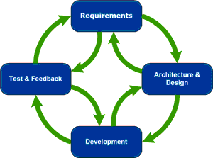
User Stories
A good way to think about a user story is that it is a reminder to have a conversation with your customer (in XP, project stakeholders are called customers), which is another way to say it's a reminder to do some just-in-time analysis. In short, user stories are very slim and high-level requirements artifacts.

Slide 11
 | User Stories
Admin | As an Admin, I want to use ―Handmade gallery, so that I can easily publish Homemade gallery, upload images, manages user stats and reports.
Users | As a user, I want to use ―Handmade so that I can easily play the Handmade gallery of multiple subjects by creating images as a reference.
Planning:
This phase is similar to the system conception phase of the Waterfall Model. Objective are determined, possible obstacles are identified and alternatives are weighted.
Risk Analysis:
The developer examined possible alternatives, and associative Risk/Problems are identified. Resolution of the risk are evaluated and weighted in the considerations of the project continuation. Sometimes prototyping is used to clarify need

Slide 12
Engineering:
Detailed requirement is determined and the software placed is developed i.e., the customer decides when the next phase of planning and risk analysis occur. If it is determined by the risk are too high, the project can be terminated.
Methodologies:
Navigation between each phase is done through data/control hierarchies, functional decomposition and requirement allocation.
Phase products presented through structure charts, state transition diagrams, and stimulus response threads.

Slide 13
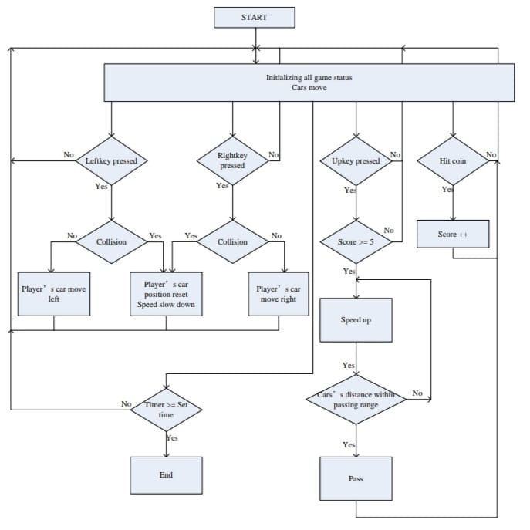
Preliminary Design
Entity Relationship Diagram
Entity Relationship Diagram

Slide 14
Use Case Diagram
Start the game
Sound off and on
Move left and right
USER
Using Accelerate
Use Case Diagram

Slide 15
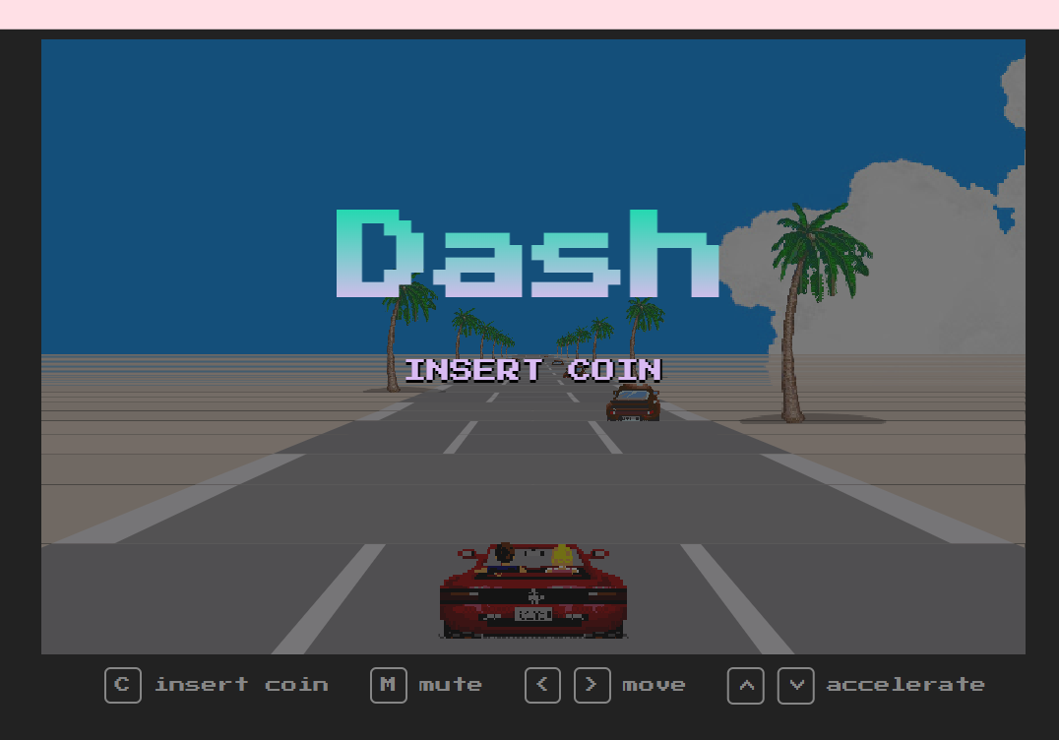
Screenshot
Insert Coin C And Start The Game

Slide 16
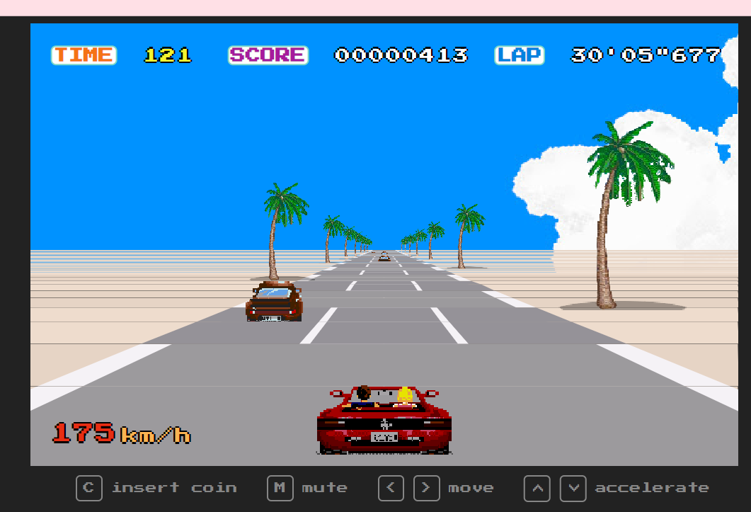
Start the Game and Enjoy

Slide 17
Conclusion
From this project, we improved our skills in programming both hardware language and software language. In the Sprite Display Module design, we have gone through programming, testing, modifying and assembling. We adopt Top-Down Design Methodology, divide the big project into several small task and modules, design general port interface. By this way, we improve our progress and make our project easy to locate where the problems are because we use small modules to limit the bug region. We believe the most valuable lesson we have learned in this project is how to debug in hardware and how to locate the bug. The bugs and problems we encountered through this project help us to enhance our knowledge of hardware design.
We used the software to implement the game logic and hardware to display graphics and audio sounds and communicated each other with software-hardware interface. During this procedure, we've encountered a lot of problems in implementing the game logic and keyboard control but we were finally able to solve all of them though we still have a lot to improve.

Slide 18
Future Scope
The game modes could be set in different difficulty levels for player to choose.
We may add joystick control in the game to make our game fancier.
The curve road part in codes could be added in a new thread in order to make the curve appears more natural and smoothly.
We may possibly add more cars.
The score can be replaced by a nitrogen bar and the coins can be replaced by nitrogen cans.
We may possibly add drift effect for player's car.
The game should be able to pause.

Slide 19
Reference
www.google.com
www.youtube.com
https://www.w3schools.com/colors/default.asp

Slide 20
Thank you

